Slide 1

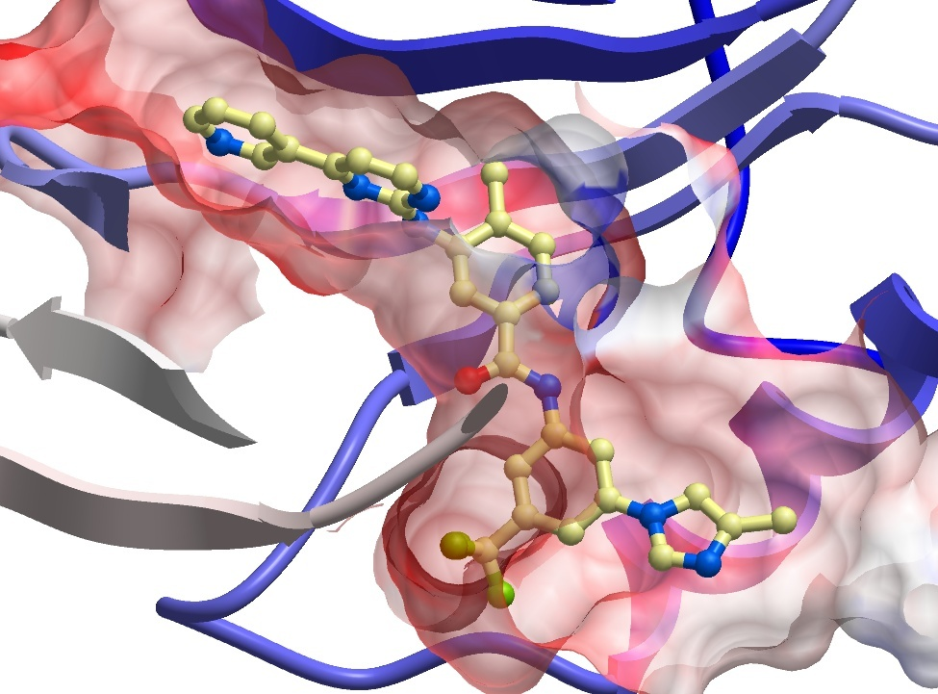






Solubility Testing for 14 compounds by DLS
Sumera Perveen
Molecular Biophysics
SGC Toronto
March 07th, 2024
SGC Frankfurt
SGC KI
SGC Neuro
SGC Toronto
SGC UNC

Slide 2
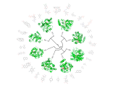

Summary
Solubility of 10 Nsp2 compounds (from Plate AViDD2196) were tested by DLS (DynaPro DLS Plate Reader III) from 50µM to 200µM, in filtered 25mM HEPES pH 7.4, 0.003% Tween-20, 1mM DTT, 2% DMSO, at 25ºC, in duplicate.
Buffer with 2% DMSO control produced laser power of 100%, and an average intensity of 578 kCounts/s.
The compounds are ranked according to increasing intensity values at 200µM.
Compound Name | ChemiReg ID | Normalized Intensity (kCnt/s) |  |  | Laser Power (%)
 |  | 50uM | 100uM | 200uM | 50uM | 100uM | 200uM
RA-0002352-02 | HL004315a | 658 | 529 | 493 | 100 | 100 | 100
RA-0002034-05 | HL004319a | NA | 1277 | 2131 | 85 | 78 | 50
RA-0002723-01 | HL004316a | NA | 2866 | 3507 | 55 | 50 | 45
RA-0020303-01 | HL004322a | 3229 | 6524 | 7015 | 28 | 20 | 15
RA-0020301-01 | HL004321a | 6939 | 10945 | 13699 | 20 | 20 | 25
RA-0020336-01 | HL004324a | 9230 | 9271 | 20151 | 30 | 35 | 25
RA-0003686-01 | HL004318a | 40045 | 58522 | 92475 | 20 | 28 | 20
RA-0002888-01 | HL004317a | 185705 | 187738 | 128167 | 18 | 10 | 20
RA-0020315-01 | HL004323a | 118777 | 178657 | 287240 | 30 | 25 | 10
RA-0020239-01 | HL004320a | 15564 | 63579 | 1418962 | 25 | 25 | 15
Molecular Biophysics

Slide 3
Summary
Solubility of 4 DENV NS5 compounds (Plate AViDD2196) were tested by DLS (DynaPro DLS Plate Reader III) from 50µM to 200µM, in filtered 25mM Tris pH 7.5, 1mM MgCl₂, and 2mM MnCl, 0.5% glycerol, 2% DMSO, at 25ºC, in duplicate.
Buffer with 2% DMSO control produced laser power of 100%, and an average intensity of 812 kCounts/s.
The compounds are ranked according to increasing intensity values at 200µM.
Compound Name | ChemiReg ID | Normalized Intensity (kCnt/s) |  |  | Laser Power (%)
 |  | 50uM | 100uM | 200uM | 50uM | 100uM | 200uM
RA-0003301-01 | HL004325a | 1367 | 1014 | 1277 | 100 | 100 | 83
RA-0020066-01 | HL004327a | 5628 | 6368 | 7304 | 35 | 20 | 25
RA-0003318-01 | HL004314b | 8266 | 9060 | 13045 | 40 | 35 | 25
RA-0003272-01 | HL004326a | 135913 | 443344 | 576675 | 20 | 20 | 15
Molecular Biophysics

Slide 4

ACKNOWLEDGEMENTS
Molecular Biophysics
SGC Toronto
Experiments in this report were performed by:
Irene Chau
Compound Management:
Albina Bolotokova
www.thesgc.org
FUNDING PARTNERS
The Structural Genomics Consortium is a registered charity (no: 1097737) that receives funds from Bayer AG, Boehringer Ingelheim, Bristol Myers Squibb, Genentech, Genome Canada through Ontario Genomics Institute [OGI-196], EU/EFPIA/OICR/McGill/KTH/Diamond Innovative Medicines Initiative 2 Joint Undertaking [EUbOPEN grant 875510], Janssen, Merck KGaA (aka EMD in Canada and US), Pfizer and Takeda.

